Slide 1
Announcements
No class on Thursday. Please use the time to read Chapter 13 of the textbook. This will be on the next midterm, but won’t be covered in lecture.
Upcoming:
HW5 – Markov Decision Processes – is due October Oct 22
Extra Credit assignment 2 has been released, it is due on Thursday October 24
Midterm 2 will be in class on Thursday October 31.
My office hours are today from 3-4pm in 3401 Walnut room 463C. I won’t have OH on Thursday.
Thanks to Hanbang, I think we have a viable solution to programming R2D2s on Linux and Windows!
Would you like an extension on EC HW1?
You can checkout a robot from my office tomorrow from 10am-4pm.
Notes:
[cut demo of moving around in grid world program]

Slide 2

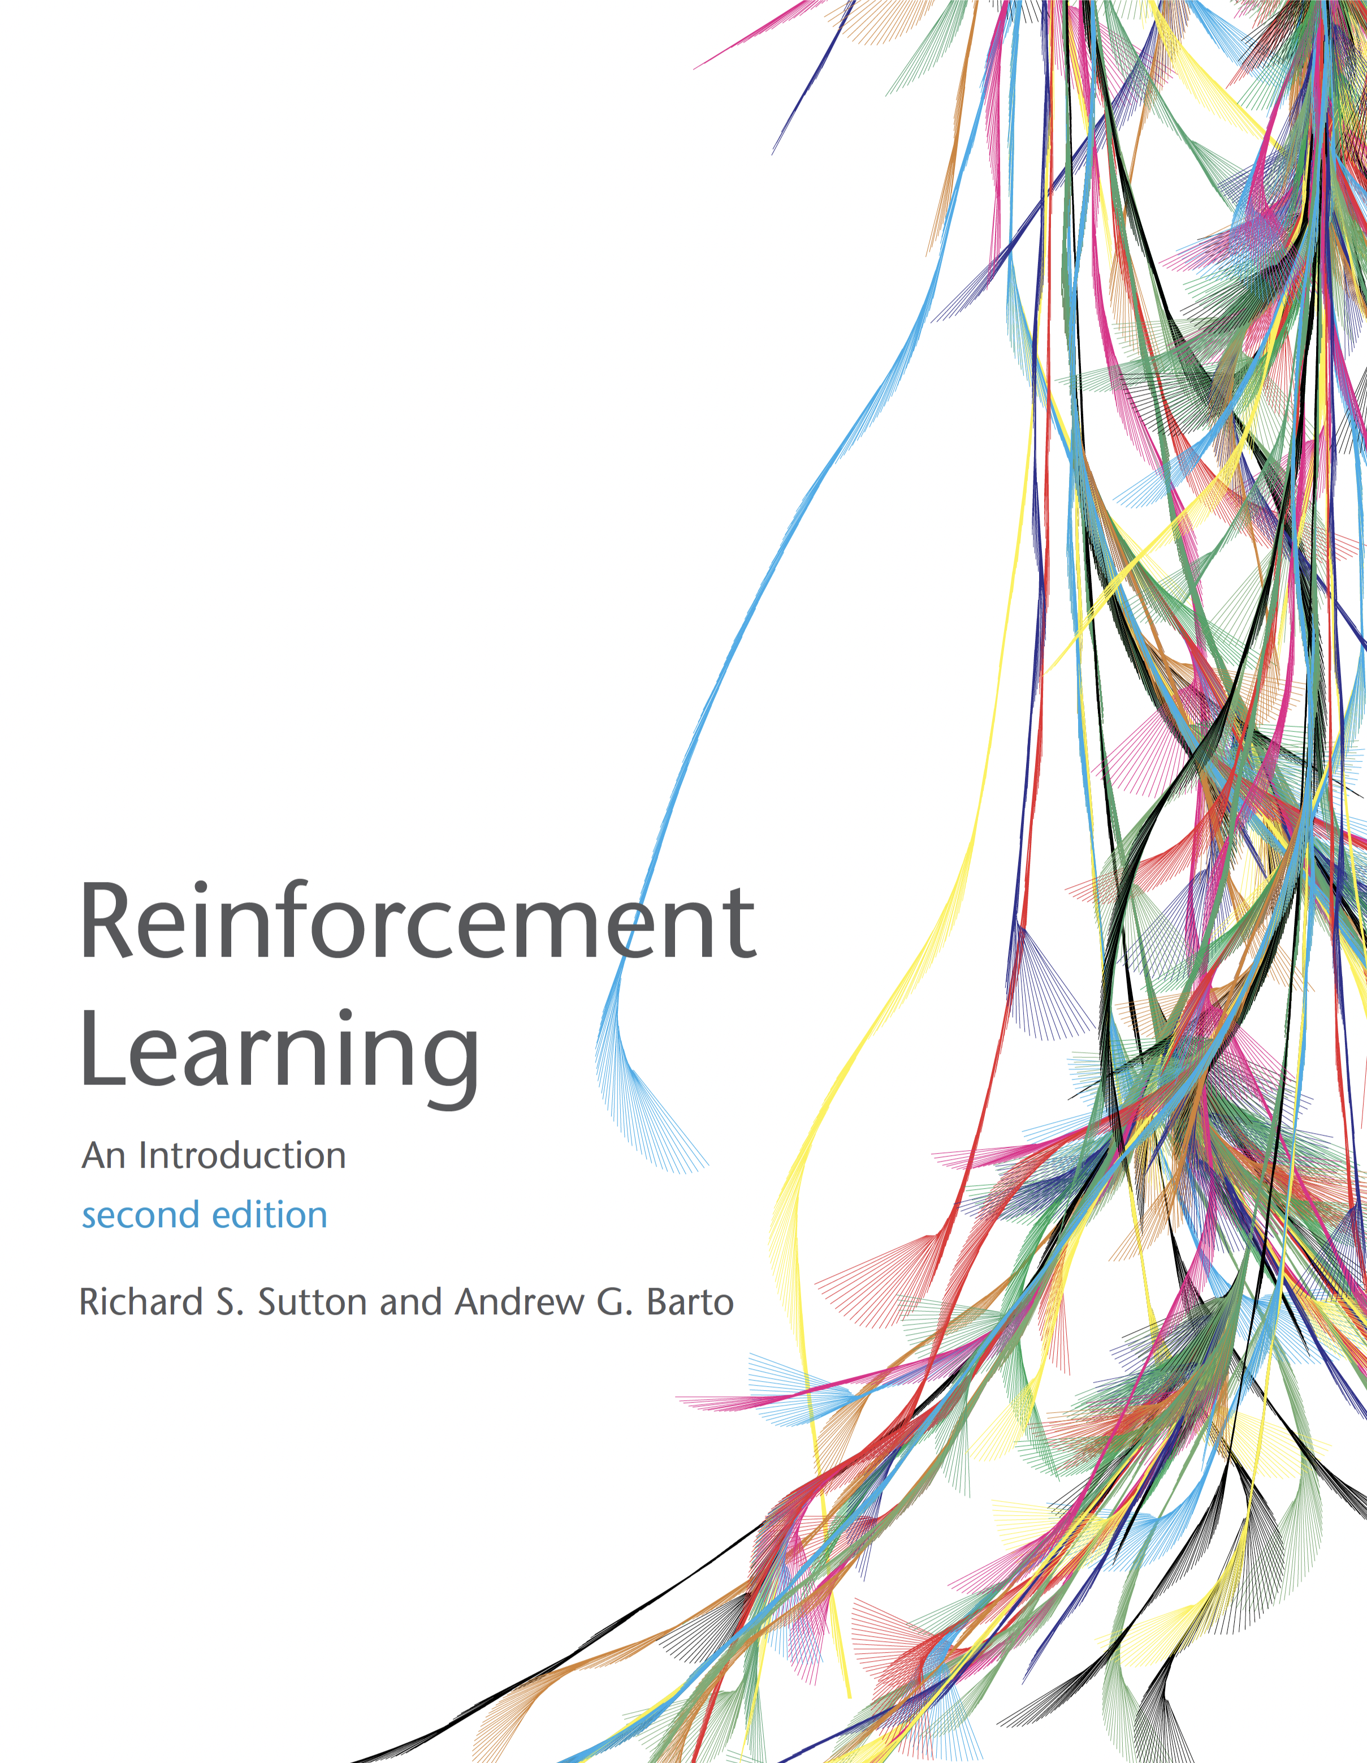
Reinforcement Learning 2
Sutton and Barto, Chapter 6.1, 6.2, 6.5 AIMA Chapter 21
Slides courtesy of Dan Klein and Pieter Abbeel University of California, Berkeley

Slide 3
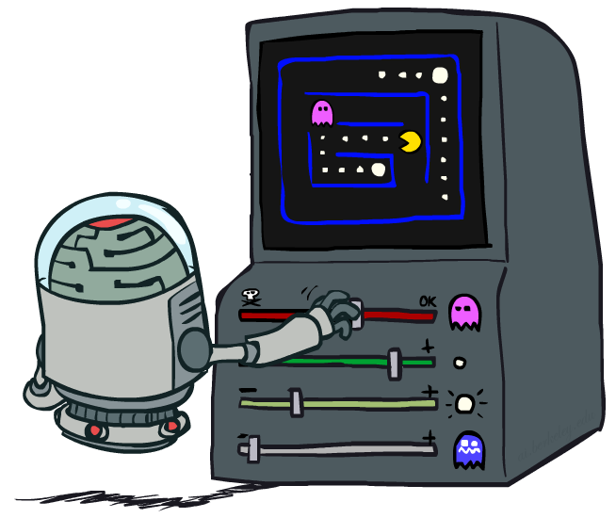
Reinforcement Learning 2
Slides courtesy of Dan Klein and Pieter Abbeel – University of California, Berkeley
[These slides were created by Dan Klein and Pieter Abbeel for CS188 Intro to AI at UC Berkeley. All CS188 materials are available at http://ai.berkeley.edu.]
Notes:
Please retain proper attribution and the reference to ai.berkeley.edu. Thanks!

Slide 4

Review: Reinforcement Learning
We still assume an MDP:
A set of states s ∈ S
A set of actions (per state) A
A model T(s,a,s’)
A reward function R(s,a,s’)
Still looking for a policy π(s)
New twist: don’t know T or R, so must try out actions
Big idea: Compute all averages over T using sample outcomes

Slide 5
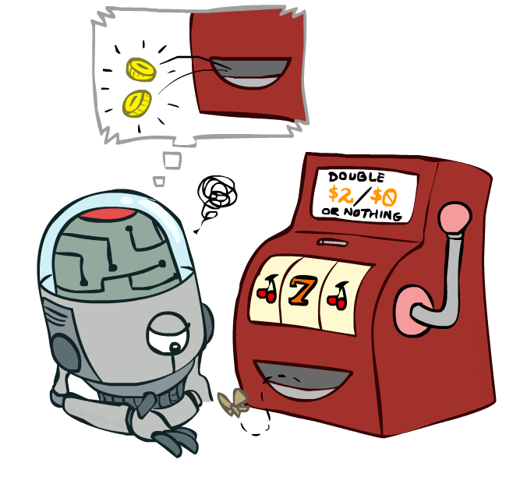
Review: Model-Free Learning
Notes:
When we left of last time we were starting to talk about model free learning.
In model free learning we don't construct a model of the transition function.
Instead, we take actions and every time we take an action we compare what we thought was going to happen to what actually did happen.
Whenever something is better or worse than what we expected we adjust our values up and down.
So what we track in a model free approach is the values of interest themselves not the transition functions or the rewards.

Slide 6
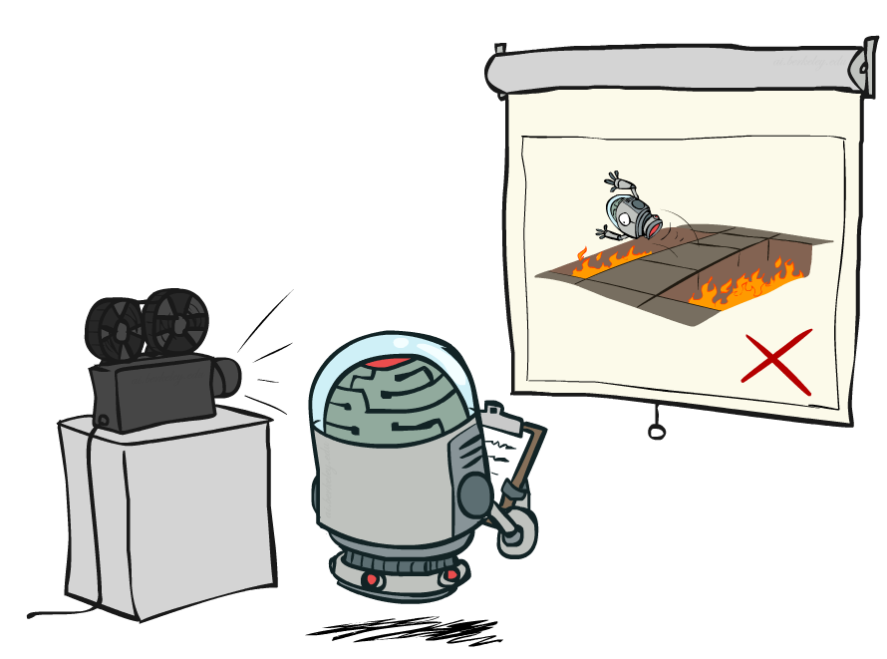
Review: Passive Reinforcement Learning
Notes:
In passive reinforcement learning, someone else chooses the policy. And we observe what happens.
The passive case is this simplified task. We're not going to try to figure out how to act optimally.
We're going try to figure out essentially what policy evaluation did.
The input is a fixed policy. We want to evaluate it.

Slide 7

Review: Passive Reinforcement Learning
Simplified task: policy evaluation
Input: a fixed policy π(s)
You don’t know the transitions T(s,a,s’)
You don’t know the rewards R(s,a,s’)
Goal: learn the state values
In this case:
Learner is “along for the ride”
No choice about what actions to take
Just execute the policy and learn from experience
This is NOT offline planning! You actually take actions in the world.

Slide 8
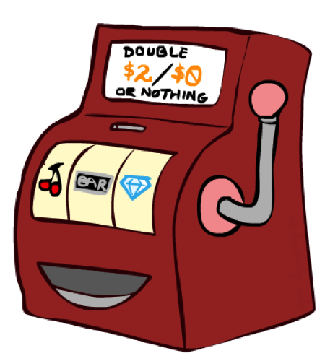
Review: Direct Evaluation
Goal: Compute values for each state under π
Idea: Average together observed sample values
Act according to π
Every time you visit a state, write down what the sum of discounted rewards turned out to be
Average those samples
This is called direct evaluation

Slide 9
Review: Example: Direct Evaluation
Input Policy π
Observed Episodes (Training)
Output Values
Episode 1
Episode 2
 | A
B | C | D
 | E
 | A
B | C | D
 | E
B, east, C, -1
C, east, D, -1
D, exit, x, +10
B, east, C, -1
C, east, D, -1
D, exit, x, +10
-10
+8
+4
+10
Episode 3
Episode 4
-2
E, north, C, -1
C, east, D, -1
D, exit, x, +10
E, north, C, -1
C, east, A, -1
A, exit, x, -10
Assume: γ = 1
Notes:
We’re given an input policy
We just want to evaluate it.
What utility did I receive from B? Not -1. That was the intentions reward. I want to compute the utility, which is from B until the end. So +8.
Write down what happened.
Why 4 for C? 9 + 9 + 9 - 11 = 16/4 = 4

Slide 10
Review: Problems with Direct Evaluation
What’s good about direct evaluation?
It’s easy to understand
It doesn’t require any knowledge of T, R
It eventually computes the correct average values, using just sample transitions
What bad about it?
It wastes information about state connections
Each state must be learned separately
So, it takes a long time to learn
Output Values
 | A
B | C | D
 | E
-10
+8
+4
+10
-2
If B and E both go to C under this policy, how can their values be different?
Notes:
One thing that’s bad about this is that the state connections aren’t effectively taken into account. For example, going from state B to state C has an expected reward of +8, but going from state E to state C has an expected reward of -2. But they are both crossing through the same state? Their values really shouldn’t be this different. So we might want to assign different values to each state with a better algorithm that via direct evaluation.

Slide 11

Review: Why Not Use Policy Evaluation Instead?
s
Simplified Bellman updates calculate V for a fixed policy:
Each round, replace V with a one-step-look-ahead layer over V
This approach fully exploited the connections between the states
Unfortunately, we need T and R to do it!
Key question: how can we do this update to V without knowing T and R?
In other words, how to we take a weighted average without knowing the weights?
π(s)
s, π(s)
s, π(s),s’
s’
Notes:
We already had an algorithm for assigning values to states with a fixed policy. It was called Policy Evaluation. It successfully exploited the connections between states. Here’s how we did it. [re-do the equation again]
Unfortunate this requires that we have a model of T and of R in order to compute the policy evaluation, but we don’t have those in model free learning. Could we do it without knowing T and R? In other words, how to we take a weighted average without knowing the weights?

Slide 12
Temporal Difference Learning
Big idea: learn from every experience!
Update V(s) each time we experience a transition (s, a, s’, r)
Likely outcomes s’ will contribute updates more often
Temporal difference learning of values
Policy still fixed, still doing evaluation!
Move values toward value of whatever successor occurs: running average
s
π(s)
s, π(s)
s’
Sample of V(s):
Update to V(s):
Same update:
Notes:
The reason this is called temporal difference learning is because we compare our current estimate of a value with what we actually see
Interprolation

Slide 13
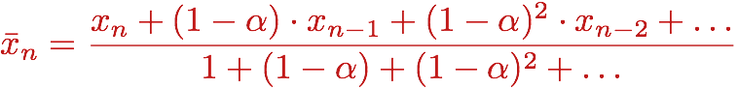
Exponential Moving Average
Exponential moving average
The running interpolation update:
Makes recent samples more important:
Forgets about the past (distant past values were wrong anyway)
Decreasing learning rate (alpha) can give converging averages

Slide 14
Example: Temporal Difference Learning
States
Observed Transitions
B, east, C, -2
C, east, D, -2
 | A
B | C | D
 | E
 | 0
0 | 0 | 8
 | 0
 | 0
-1 | 0 | 8
 | 0
 | 0
-1 | 3 | 8
 | 0
Assume: γ = 1, α = 1/2

Slide 15
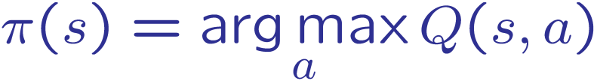
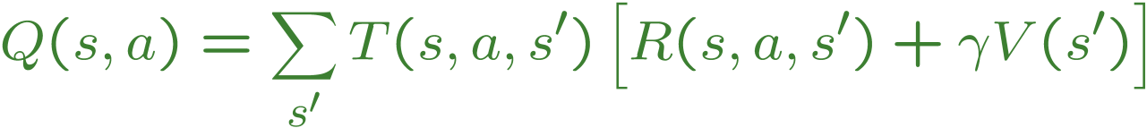
Problems with TD Value Learning
TD value leaning is a model-free way to do policy evaluation, mimicking Bellman updates with running sample averages
However, if we want to turn values into a (new) policy, we’re sunk:
Idea: learn Q-values, not values
Makes action selection model-free too!
s
a
s, a
s,a,s’
s’

Slide 16
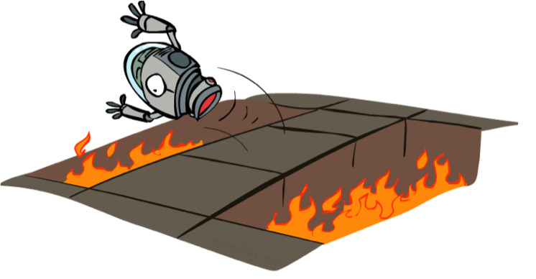
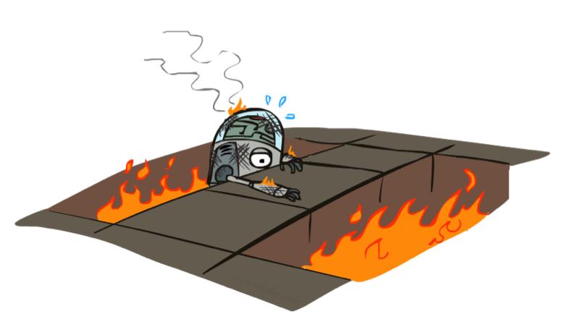
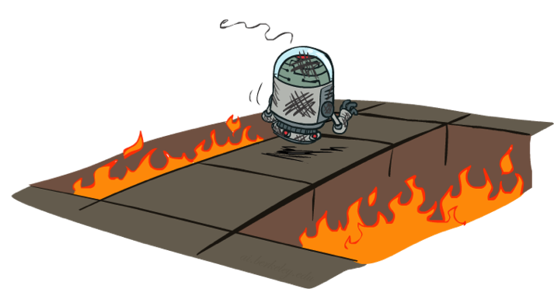
Active Reinforcement Learning

Slide 17
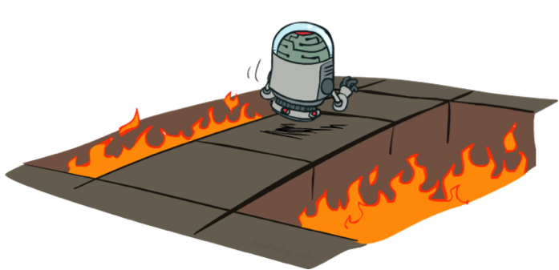
Active Reinforcement Learning
Full reinforcement learning: optimal policies (like value iteration)
You don’t know the transitions T(s,a,s’)
You don’t know the rewards R(s,a,s’)
You choose the actions now
Goal: learn the optimal policy / values
In this case:
Learner makes choices!
Fundamental tradeoff: exploration vs. exploitation
This is NOT offline planning! You actually take actions in the world and find out what happens…

Slide 18
Detour: Q-Value Iteration
Value iteration: find successive (depth-limited) values
Start with V₀(s) = 0, which we know is right
Given V_{k}, calculate the depth k+1 values for all states:
But Q-values are more useful, so compute them instead
Start with Q₀(s,a) = 0, which we know is right
Given Q_{k}, calculate the depth k+1 q-values for all q-states:

Slide 19
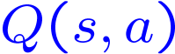
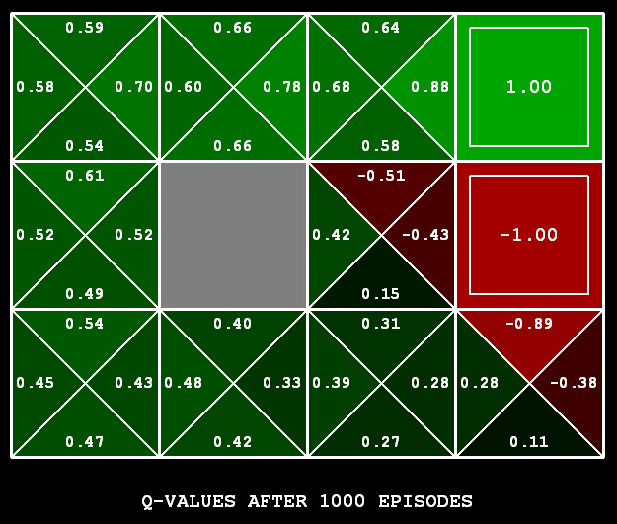
Q-Learning
Q-Learning: sample-based Q-value iteration
Learn Q(s,a) values as you go
Receive a sample (s,a,s’,r)
Consider your old estimate:
Consider your new sample estimate:
Incorporate the new estimate into a running average:

Slide 20

Video of Demo Q-Learning -- Gridworld

Slide 21

Q-Learning Properties
Amazing result: Q-learning converges to optimal policy -- even if you’re acting suboptimally!
This is called off-policy learning
Caveats:
You have to explore enough
You have to eventually make the learning rate
small enough
… but not decrease it too quickly
Basically, in the limit, it doesn’t matter how you select actions (!)

Slide 22
Review: Exponential Moving Average
Exponential moving average
The running interpolation update:
Makes recent samples more important:
Forgets about the past (distant past values were wrong anyway)
Decreasing learning rate (alpha) can give converging averages
Notes:
When we are updating our estimates of V via interpolation with alpha, we are taking an exponential moving average.
New things have more weight. In the case where alpha=1, what happens? New things have ALL of the weight.
If I unroll this, you can see that older things have less value because of the exponention. 1-alpha is going to be is less than 1. In previous time steps that means its raised to a power, and therefore the weight of the previous sample is much lower.
So we forget about the past. But that’s OK. Since the things that we were averaging is the instantaneous reward WHICH IS COMPLETELY CORRECT, and our estimate of the future reward WHICH WAS INITIALLY VERY BAD. But as we update that estimate, it gets better and better. So it actually makes total sense that we want to give greater weight to more recent samples, since they are more accurate.
Decreasing the learning rate can lead to you to converge to the correct averages. There’s an art to it. We’ll come back to that later.

Slide 23
Example: Temporal Difference Learning
States
Observed Transitions
B, east, C, -2
C, east, D, -2
 | A
B | C | D
 | E
 | 0
0 | 0 | 8
 | 0
 | 0
-1 | 0 | 8
 | 0
 | 0
-1 | 3 | 8
 | 0
Assume: γ = 1, α = 1/2
Notes:
Work through this on the board.

Slide 24
Review: Problems with TD Value Learning
TD value leaning is a model-free way to do policy evaluation, mimicking Bellman updates with running sample averages
However, if we want to turn values into a (new) policy, we’re sunk:
Idea: learn Q-values, not values
Makes action selection model-free too!
s
a
s, a
s,a,s’
s’
Notes:
Temporal Difference value learning is a model-free way of doing Bellman updates, in effect. We’re able to do it without taking the transition function into account. We just let the sample frequency do what we want to.
However, this is not going to work for the case of Active Reinforcement Learning, where we want to both run a policy and update it by transforming it into a new policy. Why is that? Well, what have we got? We’ve got a big table telling us for every state what its value is, that’ is a big table with V(s) values. The problem is that if we want to turn the values into a new policy, which is hopefully better than the old one, we’re in trouble. We know how to do that by doing 1-step of expectimax. But the problem is that requires the Transition function estimates as well.
So, the new idea that we’re going to explore is learning Q-values instead of values. This is a crucial concept in reinforcement learning. Learning Q-values makes action selection into a model-free process as well. We just look at the Q-values and pick whichever one is best.

Slide 25
Active Reinforcement Learning
Notes:
In active reinforcement learning, you have to try things. Even if they turn out to be bad. You probably won’t try it again, but you’ve learned. This is a notion called regret. We’ll learn more about that later.

Slide 26
Active Reinforcement Learning
Full reinforcement learning: optimal policies (like value iteration)
You don’t know the transitions T(s,a,s’)
You don’t know the rewards R(s,a,s’)
You choose the actions now
Goal: learn the optimal policy / values
In this case:
Learner makes choices!
Fundamental tradeoff: exploration vs. exploitation
This is NOT offline planning! You actually take actions in the world and find out what happens…
Notes:
Previously we were talking about passive reinforcement learning, where the agent followed a fixed policy. In full reinforcement learning, we want the agent to be able to select its own policy, and hopefully converge towards an optimal policy.
We still don’t know the probabilities or the rewards. But we can pick it out now.
So, we’re going to let the learner start to make choices instead of following a fixed policy.

Slide 27
Q-Learning
Q-Learning: sample-based Q-value iteration
Learn Q(s,a) values as you go
Receive a sample (s,a,s’,r)
Consider your old estimate:
Consider your new sample estimate:
Incorporate the new estimate into a running average:
Notes:
In Q-learning, we’re going to replace the Q-value with a one-step look ahead sample.
This will allow us to do it as we go, and therefore do active Reinforcement Learning without having a model.
Every time we are in a state S, we’ll take an action A. We’ll learn how good S A is.
We’ll maintain a table that looks like this.
We’re in S, we do A, and we get a sample (s, a, s’, r). That tells us something about the world.
Sample tells us the instantaneous reward, R(s, a, s’), plus the old estimate of Q(s’, a’) – discounted by gamma.
We can incorporate this into a running average like this:
(Write the equation).
This is q-learning. It is awesome.

Slide 28
Q-Learning Properties
Amazing result: Q-learning converges to optimal policy -- even if you’re acting suboptimally!
This is called off-policy learning
Caveats:
You have to explore enough
You have to eventually make the learning rate
small enough
… but not decrease it too quickly
Basically, in the limit, it doesn’t matter how you select actions (!)
Notes:
There is an amazing result here. Q-learning converges to OPTIMAL policy, even if you’re NOT FOLLOWING IT!!!!
This is called off-policy learning (you don’t have to follow the perfect policy in order to learn it).
There are a few caveats. Basically, in the limit, it doesn’t matter how you select actions – you can jump of the cliff a lot, but you’ll still be able to learn the optimal policy.

Slide 29
Review: Reinforcement Learning
We still assume an MDP:
A set of states s ∈ S
A set of actions (per state) A
A model T(s,a,s’)
A reward function R(s,a,s’)
Still looking for a policy π(s)
New twist: don’t know T or R, so must try out actions
Big idea: Compute all averages over T using sample outcomes

Slide 30
The Story So Far: MDPs and RL
Known MDP: Offline Solution
Goal Technique
Compute V*, Q*, π* Value / policy iteration
Evaluate a fixed policy π Policy evaluation
Unknown MDP: Model-Based
Unknown MDP: Model-Free
Goal Technique
Compute V*, Q*, π* VI/PI on approx. MDP
Evaluate a fixed policy π PE on approx. MDP
Goal Technique
Compute V*, Q*, π* Q-learning
Evaluate a fixed policy π Value Learning
Notes:
By now, you’ve seen a lot of things that qualify as Bellman equations. Equations that relate the value one state to the value one state later, after one action.
You’ve seen q-values in term of q-values. You’ve seen some with pis, and some with stars. By now, you may in Bellman equation overload.
All these things, when you aren’t use to them, look the same. And the good news, is that when you are used to them, they still all look the same. They’re all just expeictmax written out in different ways. There’s a max when I’m acting optimally. Sometimes there’s a pi when I’m fixed to a policy. Anything we can do with values, we can do either with values or q-values since it’s just a matter of where we start our recurrence in expectimax. Do I start at a state, which evaluates a state, or a q-state which evaluates an action?
For MDPs, we know the probabilities, so we can compute the solutions online. For reinforcement learning, we don’t know the value, so that requires new ways of solving the problem. We’re going to dive into q-learning now.

Slide 31
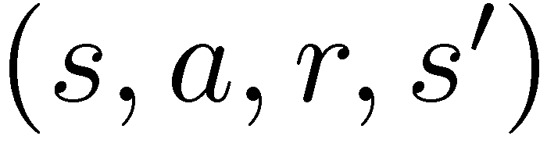
Model-Free Learning
s
Model-free (temporal difference) learning
Experience world through episodes
Update estimates each transition
Over time, updates will mimic Bellman updates
a
s, a
r
s’
a’
s’, a’
s’’
Notes:
What does model free learning mean? The agent experiences the world through a stream of transitions that form episodes. For example, you start in state S, you take an action (forget for a second where we know to take that action), then you land in state s’ you take action a’, you end in state s’’.
Every transition is going to cause you to learn about the world, and improve the world. Over time these updates will mimic Bellman updates.

Slide 32
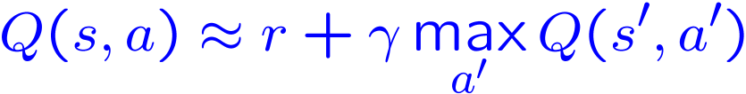
Q-Learning
We’d like to do Q-value updates to each Q-state:
But can’t compute this update without knowing T, R
Instead, compute average as we go
Receive a sample transition (s,a,r,s’)
This sample suggests
But we want to average over results from (s,a) (Why?)
So keep a running average
Notes:
People were held back for decades by staring at value updates. In short, the problem was that they require first doing a max, and we can’t compute that by sampling.
Bye we shouldn’t really be evaluating values anyway. We should be evaluating actions. The value of an action is its Q-value.
So here’s how that works. In this case it’s q-value iteration. If we knew the MDP, we would do it like in equation 1. Now instead of having a max on the outside, we have an average. We know how to do that with sampling. Here’s how….
On the basis of one sample, what can we conculde about the Q-state, <s, a>. We’ve got a reward r, plus the maximum of the future actions, since we assume we’ll continue to act soptimally.
We keep a running average. It constantly maintains Q(s, a). Every time we receive an instaneous sample, we fold it in with weight 1-alpha.

Slide 33
Q-Learning Properties
Amazing result: Q-learning converges to optimal policy -- even if you’re acting suboptimally!
This is called off-policy learning
Caveats:
You have to explore enough
You have to eventually make the learning rate
small enough
… but not decrease it too quickly
Basically, in the limit, it doesn’t matter how you select actions (!)
[Demo: Q-learning – auto – cliff grid (L11D1)]
Notes:
There is an amazing result here. Q-learning converges to OPTIMAL policy, even if you’re NOT FOLLOWING IT!!!!
This is called off-policy learning (you don’t have to follow the perfect policy in order to learn it).
There are a few caveats. Basically, in the limit, it doesn’t matter how you select actions – you can jump of the cliff a lot, but you’ll still be able to learn the optimal policy.

Slide 34
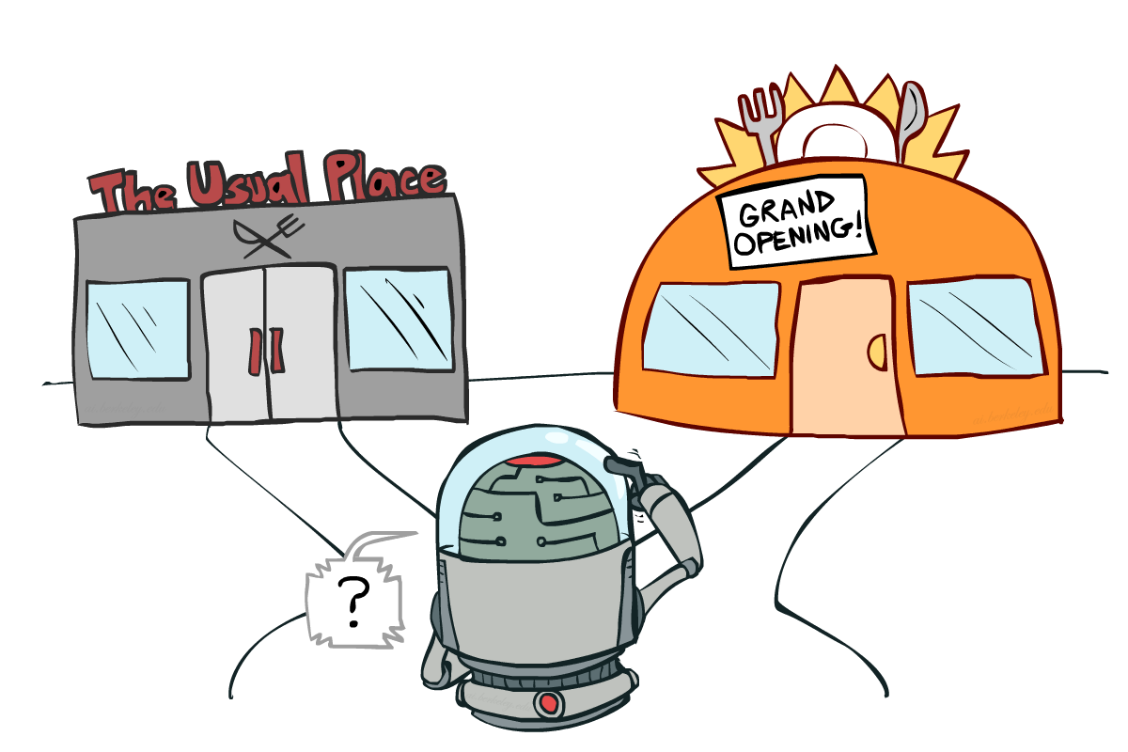
Exploration vs. Exploitation
Notes:
So what does q-learning require in order for us to learn an optimal policy.
It requires that you explore enough,.
One of the most important things in reinforcement learning is an inevitable trade off between exploration and exploitation.
You have to try some stuff. You have to make some mistakes.
Exploration may be disastrous. The food might be terrible. You may get food poisoning. But it may be your new favorite restaurant. If you don’t explore it, then you might miss out on your favorite restaurant until the end of time.

Slide 35

How to Explore?
Several schemes for forcing exploration
Simplest: random actions (ε-greedy)
Every time step, flip a coin
With (small) probability ε, act randomly
With (large) probability 1-ε, act on current policy
Notes:
Q-learning didn’t specify how to select actions.
This tells us how to selection actions to allow q-learning to do it’s magic.
The simplest way to act is called an Epsilon greedy policy. At every time step, with some (presumably small) probability, we choose something randomly.
With a presumably large probability, we act on our current policy.
A lot of random actions without not much progress.

Slide 36
How to Explore?
Several schemes for forcing exploration
Simplest: random actions (ε-greedy)
Every time step, flip a coin
With (small) probability ε, act randomly
With (large) probability 1-ε, act on current policy
Problems with random actions?
You do eventually explore the space, but keep thrashing around once learning is done
One solution: lower ε over time
Another solution: exploration functions
Notes:
Q-learning didn’t specify how to select actions.
This tells us how to selection actions to allow q-learning to do it’s magic.
The simplest way to act is called an Epsilon greedy policy. At every time step, with some (presumably small) probability, we choose something randomly.
With a presumably large probability, we act on our current policy.
A lot of random actions without not much progress.

Slide 37
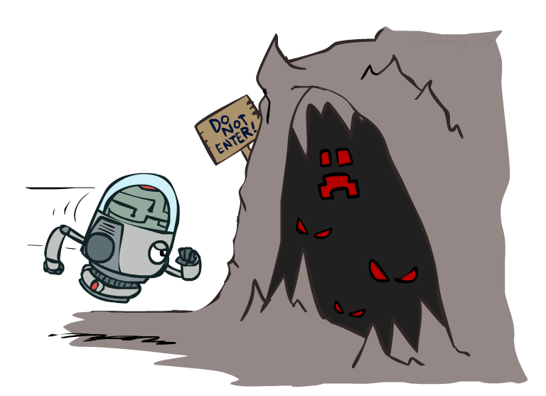
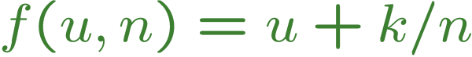
Exploration Functions
When to explore?
Random actions: explore a fixed amount
Better idea: explore areas whose badness is not
(yet) established, eventually stop exploring
Exploration function
Takes a value estimate u and a visit count n, and
returns an optimistic utility, e.g.
Note: this propagates the “bonus” back to states that lead to unknown states as well!
Regular Q-Update:
Modified Q-Update:
Notes:
When should you explore? We’ll we could try a fixed amount of randomness, or we could explore areas where the badness has not yet been established.
You should have optimism in the face of uncertainty! Go boldly into that dark cave.
We can quantify this by defining an exploration function F. It takes in a value estimate of the utility U and a count of how often we’ve visited N. For Q states N is the number of times we’ve tried that option out.
We take the utility, and we add a bonus k/n that decreases over time as we increase the number of samples. K lets us determine how much exploration to do.
Here’s our regular Q update. …
We can modify it by this term that boosts it with this function that gives us a reason to explore unknown states.

Slide 38
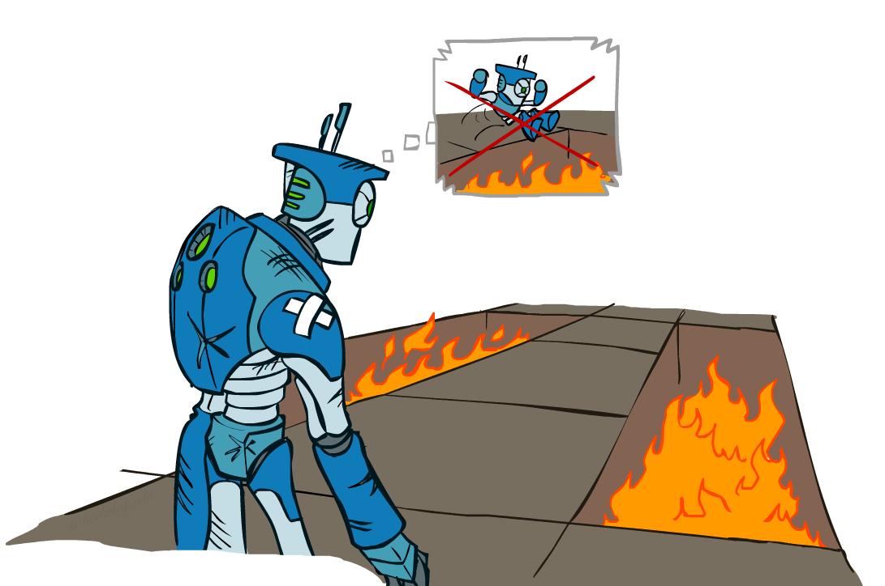
Regret
Even if you learn the optimal policy, you still make mistakes along the way!
Regret is a measure of your total mistake cost: the difference between your (expected) rewards, including youthful suboptimality, and optimal (expected) rewards
Minimizing regret goes beyond learning to be optimal – it requires optimally learning to be optimal
Example: random exploration and exploration functions both end up optimal, but random exploration has higher regret
Notes:
This brings us to the idea of regret. It’s one of those terms that has an everyday meaning, but it has a very specific meaning in this course.
You don’t get to be the wise optimal robot without making some mistakes in your youth. Here’s the wise old robot remembering when it was young and jumping into fire pits. You don’t learn an optimal policy without doing so.
Read 2nd bullet. Why expected? Because there’s some randomness to the world, which any optimal policy must account for.
Minimizing regret is like optimally learning to be optimal.

Slide 39
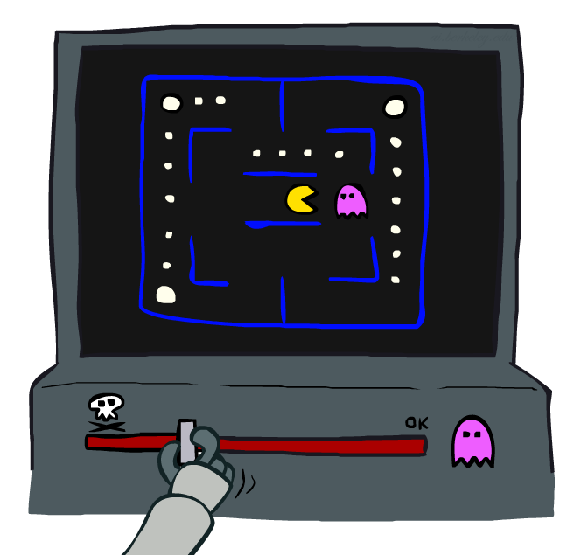
Approximate Q-Learning
Notes:
What do you do in a game like PacMan when there are so many states, that you can’t possibly learn about every one.
The basic idea is called approximate Q-Learning. When you learn that a ghost is bad, you should transfer that to other states that have ghosts.

Slide 40

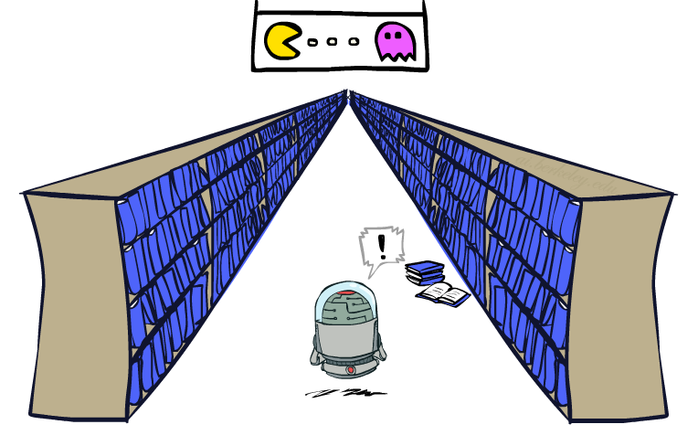
Generalizing Across States
Basic Q-Learning keeps a table of all q-values
In realistic situations, we cannot possibly learn about every single state!
Too many states to visit them all in training
Too many states to hold the q-tables in memory
Instead, we want to generalize:
Learn about some small number of training states from experience
Generalize that experience to new, similar situations
This is a fundamental idea in machine learning, and we’ll see it over and over again
Notes:
For ever cell and every action, you’ve got a table of values that you’re storing.
The problem is that for games like PackMan there are too many states to hold in memory, so many that you can’t hold them all in memory.
Instead, we want to generalize. This is a fundamental idea in machine learning.
You want to be able to generalize not just to save on time and storage, but because it’s better. You’re going to learn faster through generalization.

Slide 41
Flashback: Evaluation Functions
Evaluation functions score non-terminals in depth-limited search
Ideal function: returns the actual minimax value of the position
In practice: typically weighted linear sum of features:
e.g. f₁(s) = (num white queens – num black queens), etc.

Slide 42
Linear Value Functions
Using a feature representation, we can write a q function (or value function) for any state using a few weights:
Advantage: our experience is summed up in a few powerful numbers
Disadvantage: states may share features but actually be very different in value!
Notes:
This gives us linear value functions.
For state evaluation we had V(s), like what we did for Chess.
For reinforcement learning, we do Q(S,A), where we’re evaluating the actions as well as the state.
We’ll allow the learning algorithm to set the weights automatically.

Slide 43

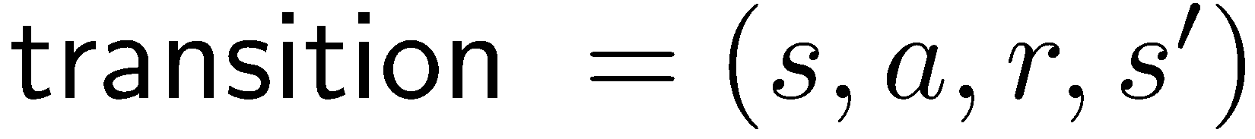
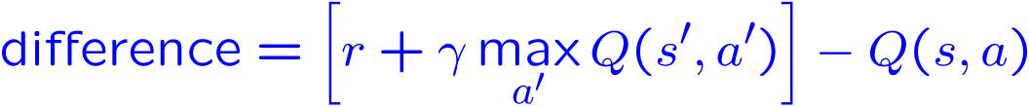
Approximate Q-Learning
Q-learning with linear Q-functions:
Intuitive interpretation:
Adjust weights of active features
E.g., if something unexpectedly bad happens, blame the features that were on: disprefer all states with that state’s features
Formal justification: online least squares
Exact Q’s
Approximate Q’s
Notes:
Here’s the magic equation for approximate q-learning.
I give you the state and the action, and out pops the value.
So how do we do learning with this type of Q function?
The first part of the learning algorithm doesn’t actually care where the Q value came from. It says, give me a transition so that I can learn.
We then take a difference. I thought that we were going to get Q(S,A0. I now think that I’m going to this reward, plus some discounted future reward. So the difference is essentially an ERROR TERM. It’s the difference between what we thought we would get and what we seemed to be about to get on the basis of the this one step ahead experience.
For an exact inference it’s this. This is just the algebraic re-write of taking alpha of one, and 1-alpha of the other.
Basically what we do is we keep our Q value around, and then nudge it in the direction of who we were wrong.
It would be really easy to update this value if we were storing Q values in a table. However, now we’re strong Q values as a linear sum, and the only parameters we can adjust are the weights.
If we determine that my Q value wasn’t high enough for this state, then we need to change the weights to make it higher.
The way that we do that is to increase the weights? Which ones? All of them, but in proportion to the feature value. If it’s negative we’re actually going to decrease its weight because of the sign change.
You compute how wrong you were, and you try to adjust the weights to fix it.
Intuitive interpretation is to adjust these sliders.

Slide 44
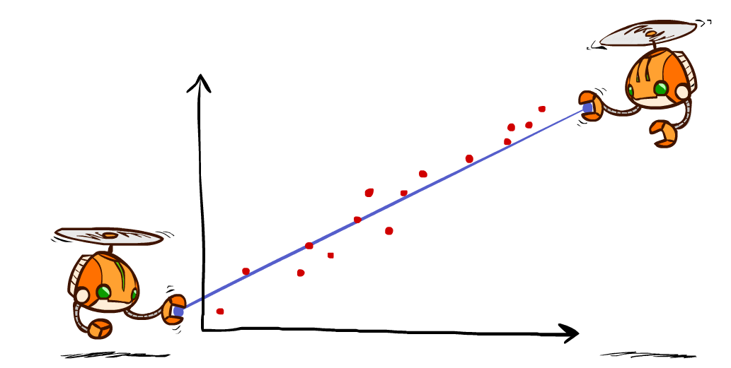
Q-Learning and Least Squares
Notes:
We’re going to take a quick look to see why this update makes sense. We can formally justify the approximate q-learning updates with least quares.

Slide 45
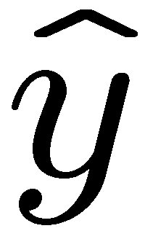
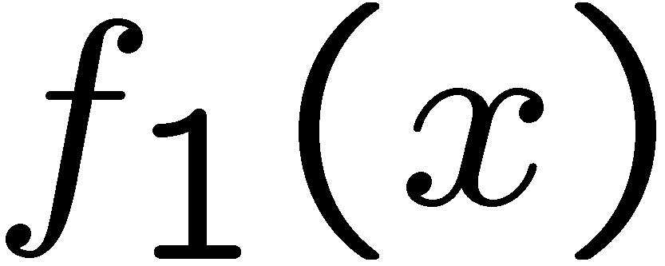
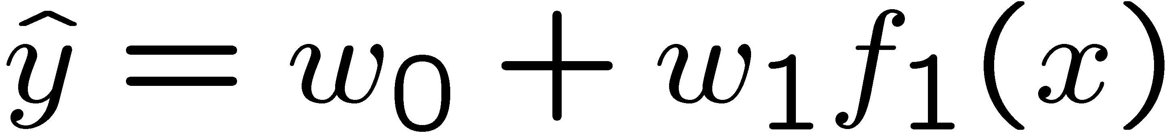
Linear Approximation: Regression*
40
26
24
20
22
20
30
20
40
0
0
20
30
10
20
0
10
0
Prediction:
Prediction:
Notes:
W0 is an intercept term, which corresponds to a bias feature that we’ll always set to 1.
Here we only have 1 real feature f_1.
The prediction is Y hat.
This can happen in multiple dimensions. The dimensionality increases with the number of features.
How do we find good values for the features, given a bunch of data points? No q-learning, no robots, just in general.
Figure 1: scatter(1:20,10+(1:20)+2*randn(1,20),'k','filled'); a=axis; a(3)=0; axis(a);

Slide 46
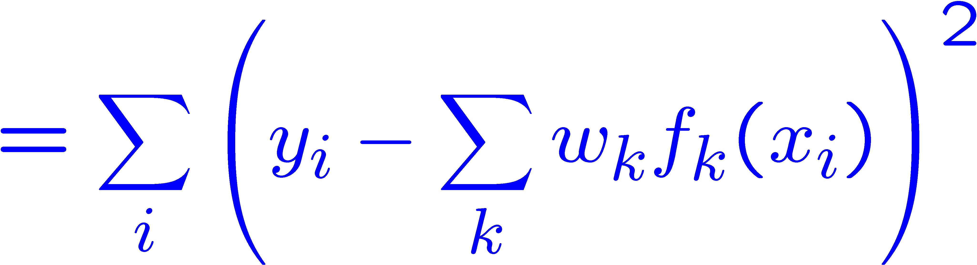
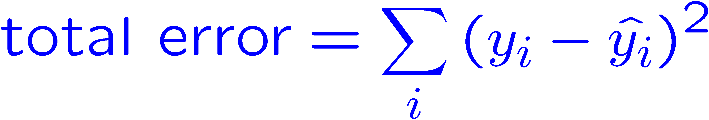
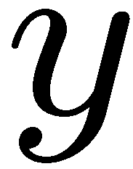
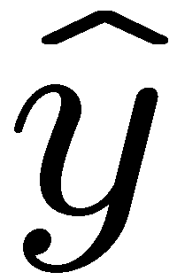

Optimization: Least Squares*
Error or “residual”
Observation
Prediction
0
0
20
Notes:
I’ve got some prediction Y HAT that is determined by the weights. Better weights will get us closer to the true observation Y.
We can quanitfy how wrong we are with one set of weights as the sum of the differences between our predictions and the truth. We square it because being off in the positive or negative directions are both bad.
Then our predictions can be expressed in terms of the K features in this linear form with the features of X.
We should move the weights to make this error small. This is how we derive the formula for linear regression.

Slide 47
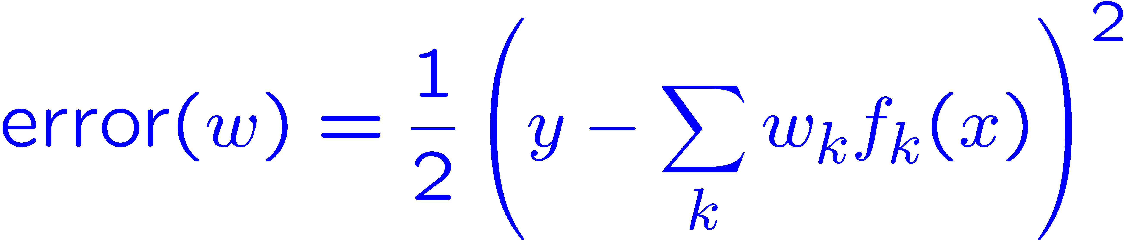
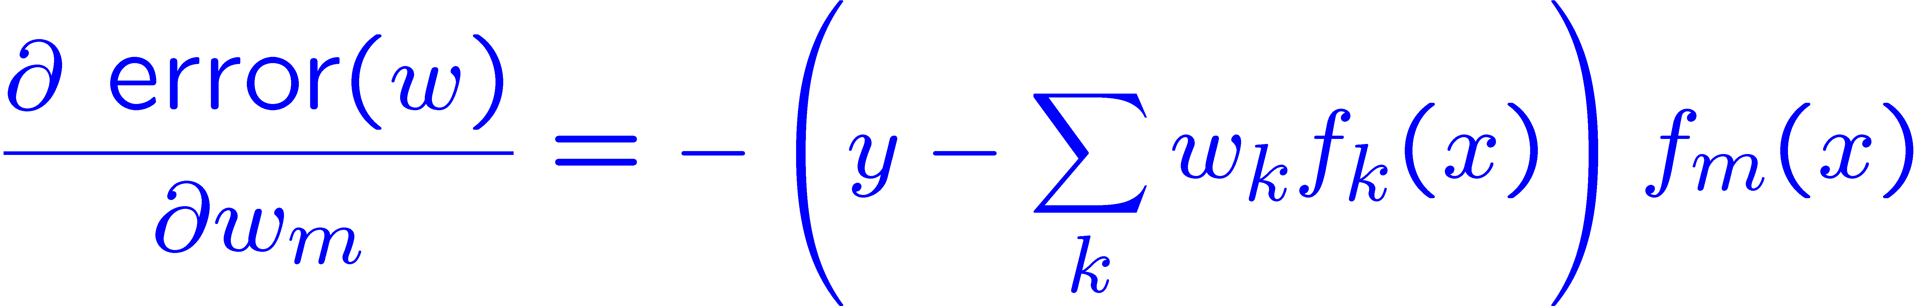
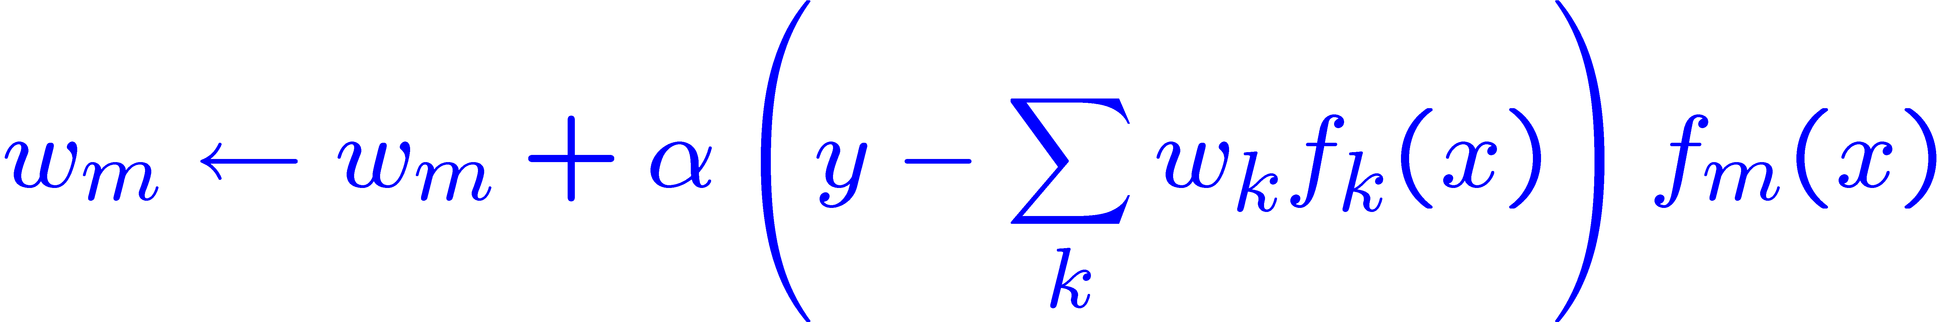
Minimizing Error*
Imagine we had only one point x, with features f(x), target value y, and weights w:
Approximate q update explained:
“target”
“prediction”
Notes:
Here’s how we can write out the error on just one point.
It’s the difference between the truth and the prediction.
Then we stick a ½ in front of it. That doesn’t do anything, but it will help us with the calculus in the next step.
We take a derivative with respect to a certain weight.
Then the derivative of the error is this expression. To make the error big, go in the direction of the feature weights that are making this wrong.
So we want to minimize the error, so we update the weights with the inverse of that.
And that’s how we explain the form of the q-update. Where instead of Y, we have the observed reward, and instead of the prediction Y HAT, we have our previous prediction Q(S,A)

Slide 48
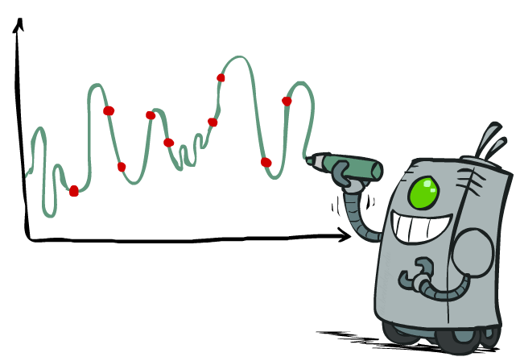
Overfitting: Why Limiting Capacity Can Help*
30
25
20
Degree 15 polynomial
15
10
5
0
-5
-10
-15
0
2
4
6
8
10
12
14
16
18
20
Notes:
Why linear? Why a small amount of features? It’s to avoid overfitting. You can draw a complex squiggle to connect all of the points like this.

Slide 49

Policy Search
Notes:
One last important thing about how these things work in practice.
Q-learning will only take us so far, so in practice people do something a bit different called policy search.

Slide 50
Policy Search
Problem: often the feature-based policies that work well (win games, maximize utilities) aren’t the ones that approximate V / Q best
E.g. your value functions from project 2 were probably horrible estimates of future rewards, but they still produced good decisions
Q-learning’s priority: get Q-values close (modeling)
Action selection priority: get ordering of Q-values right (prediction)
We’ll see this distinction between modeling and prediction again later in the course
Solution: learn policies that maximize rewards, not the values that predict them
Policy search: start with an ok solution (e.g. Q-learning) then fine-tune by hill climbing on feature weights
Notes:
The problem with Q-learning is that we’re trying to get the values close to the truth. It doesn’t try to order the values. In selection an action, we really only care about the difference between the best choice and the others.
The solution to this is to learn policies policies that maximize rewards, not the values that predict them.
Policy search might start with Q-learning. Then hill climb on the feature weights.

Slide 51
Policy Search
Simplest policy search:
Start with an initial linear value function or Q-function
Nudge each feature weight up and down and see if your policy is better than before
Problems:
How do we tell the policy got better?
Need to run many sample episodes!
If there are a lot of features, this can be impractical
Better methods exploit look ahead structure, sample wisely, change multiple parameters…
Notes:
Here’s the simplest way to do policy search.
Start with something in the ball park, and then nudge the feature weights to see if we get a better policy. We don’t actually have to do Q-learning or its look aheads.

Slide 52
Term Project
Pick a topic from the class, and write a program to demonstrate how it can apply to your robots. Short write-up or video to describe what you did.
Teams of up to 5 people.
Examples:
8 Puzzle to sort grid of robots into ascending order by ID
Adversarial search for a game between R2D2 and R2Q5
Natural language processing for robots (translate commands into code)
Alternate: do one of last year’s homework assignments (on your own, not with a team).

Slide 53
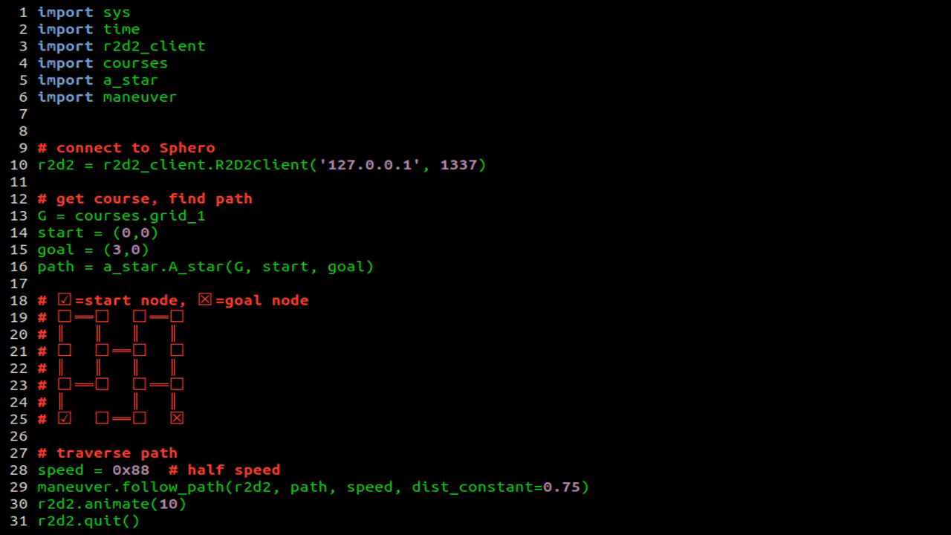
In class exercise: Robot Navigation with A*
https://www.youtube.com/watch?v=qjIhtkhbPT8

